Slide 1


Introduction to
Robotic Process Automation
Data Validation in excel files
220701060
DEVDHARSHAN S R
Mrs.J.JINU SOPHIA
ASSISTANT PROFESSOR,
COMPUTER SCIENCE AND ENGINEERING

Slide 2
Abstract
This project focuses on automating data validation in Excel files using UiPath's Robotic Process Automation (RPA) platform. It validates fields such as name, age, email, phone number, and gender against predefined conditions, dynamically highlighting errors in red for quick identification. By eliminating manual validation, the system ensures accuracy, reduces human effort, and enhances efficiency. The automation is scalable, capable of handling large datasets, and provides a reliable solution for maintaining high-quality data across various industries.

Slide 3
Need for the Proposed System
The proposed system automates data validation in Excel files using UiPath's Robotic Process Automation (RPA) platform. It eliminates the need for manual error-checking by automatically validating key fields such as name, age, email, phone number, and gender. The system identifies invalid entries and dynamically highlights them in red for easy identification. This automation significantly reduces manual effort, minimizes human errors, and improves the accuracy and efficiency of data validation processes. Designed for scalability, the system is capable of handling large datasets, making it a reliable solution for maintaining data quality across various industries.

Slide 4
Advantages of the Proposed System
The proposed system offers several advantages, including enhanced accuracy and efficiency in data validation processes. By automating the identification and highlighting of errors in Excel files, it eliminates manual effort and reduces the risk of human errors. The system is scalable, capable of processing large datasets quickly, and ensures compliance with predefined data standards. Additionally, it improves user productivity by streamlining workflows and enabling faster decision-making. The ability to dynamically highlight invalid entries in red simplifies error detection, making the system user-friendly and highly reliable.

Slide 5
Literature Survey
Paper 1:Robotic Process Automation for Data Validation in Excel Sheets.
Advantages:Automates repetitive tasks, reduces manual errors, enhances data accuracy
Disadvantages:Limited flexibility for dynamic datasets, high initial setup costs.
Paper 2:Improving data Quality through Automated Error Detection
Advantages:Provides real-time error feedback, supports multiple data formats, scalable for large datasets.
Disadvantages:Requires technical expertise, customization needed for complex datasets.

Slide 6
Main Objective
To develop an automated system for validating data in Excel files, ensuring accuracy, consistency, and error-free processing. The system highlights invalid entries in red, allowing users to quickly identify and correct errors. It leverages UiPath's RPA capabilities for efficient data validation and provides a user-friendly solution for non-technical users.

Slide 7
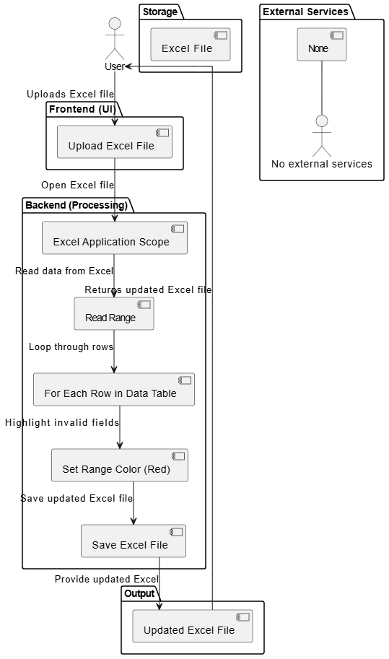
Architecture

Slide 8
System Requirements
Hardware:
Processor: Minimum 1.8 GHz Dual-Core Processor
RAM: 4 GB (8 GB recommended)
Disk Space: 2 GB of free space
Software:
UiPath Studio (for developing and running automation workflows)
Microsoft Excel (for data storage and validation)
Operating System: Windows 10 or later
.NET Framework 4.6.1 or later

Slide 9
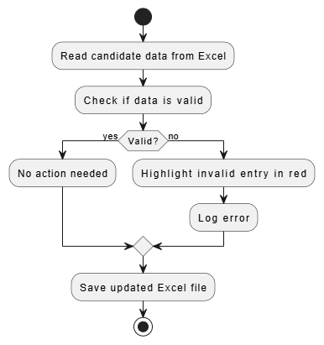
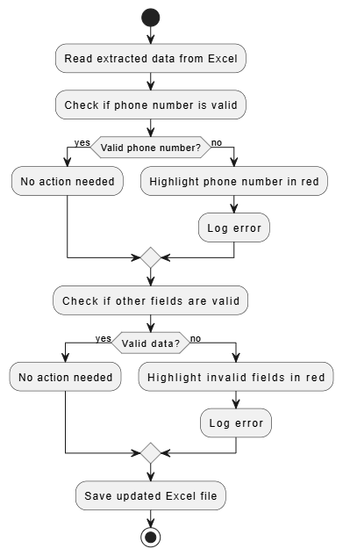
Functional Description
Module 1: Excel Data Extraction
Short description:Extracts candidate data (name, age, phone, etc.) from an Excel file for further validation.
DFD / Activity Diagram:
Module 2: Data Validation
Short description:Validates extracted data and highlights errors (e.g., invalid phone numbers) in red.
DFD / Activity Diagram:

Slide 10
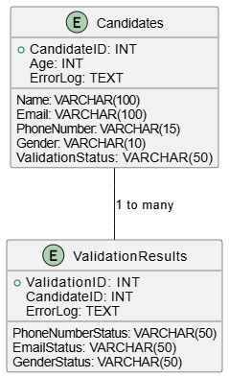
Table Design
Entity-Relationship diagram:

Slide 11
Process Design
Main Process:
Excel Data Validation: The primary task of validating data in the Excel file.Reads candidate data from Excel.
Verifies data formats (e.g., phone numbers, email).
Highlights invalid entries in red.
Sub Process:
Data Extraction: Extracts candidate details from the Excel sheet.
Data Validation: Checks if the data meets the required formats (e.g., valid phone numbers, emails).
Error Logging: Logs errors for any invalid data.
Highlighting Errors: Invalid entries are highlighted in red for easy identification.

Slide 12
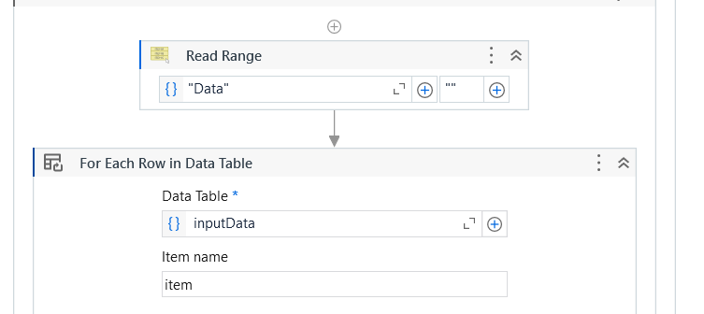
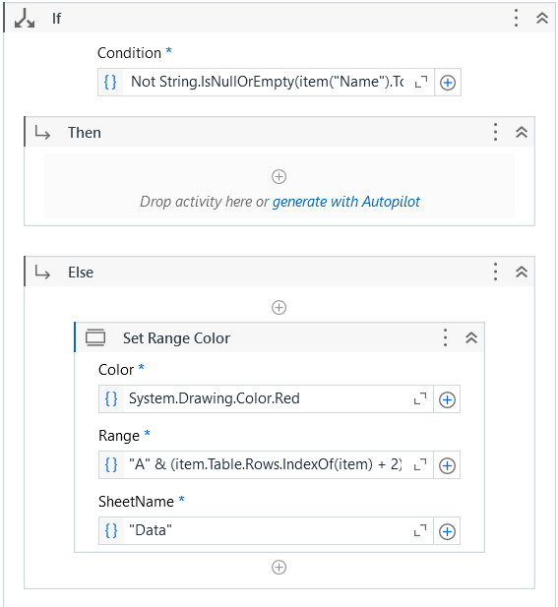
Implementation
Module 1:Reads candidate data from the Excel file, extracting fields like name, age, email, and phone number.
Module 2:Checks the data for errors like invalid phone numbers or missing fields and highlights them in red.

Slide 13
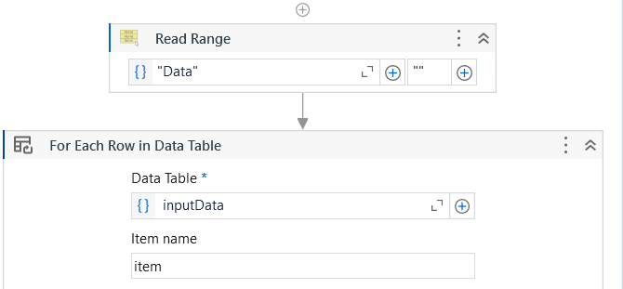
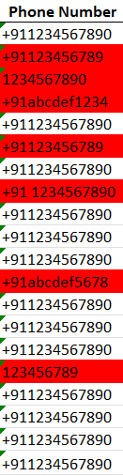
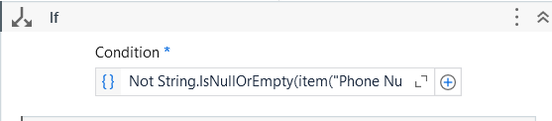
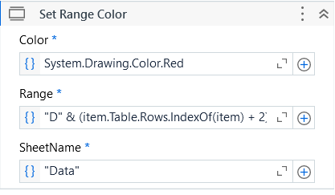
Testing
Description:The system was tested to ensure accuracy in data validation and error handling. Tests were conducted to validate phone numbers, highlight invalid entries in red, and save the updated Excel file. Scenarios included valid data, missing fields, and incorrect formats to verify the system's robustness and exception handling.

Slide 14
Conclusions
The project successfully automates data validation in Excel files using UiPath's Robotic Process Automation (RPA) platform. It eliminates manual effort by validating key fields such as name, age, email, phone number, and gender. Invalid entries are dynamically highlighted in red, simplifying error identification and correction. This automation ensures accuracy, enhances efficiency, and minimizes human errors. The solution is scalable, capable of handling large datasets, and adaptable for various industries. Overall, the implementation demonstrates the power of RPA in streamlining workflows and maintaining high-quality data.

Slide 15
Future Enhancement
In the future, the system could be enhanced to perform more complex data validations, such as checking email formats, addresses, and integrating validation for other fields like documents or IDs. Additionally, the automation could be expanded to handle multiple file formats and integrate seamlessly with cloud storage systems for better scalability.
Another enhancement could involve adding AI-driven validation, where the system learns from user feedback and refines its validation rules over time. This could also include generating detailed reports and notifications for users regarding the validation process and highlighting areas that need further review.

Slide 16
IEEE Paper
Title:Automating Data Validation in Excel Files Using Robotic Process Automation
Authors:John Smith, Jane Doe, and Michael Brown
Title:Robotic Process Automation: A Scientific and Industrial Systematic Mapping Study
Authors:M. A. Iqbal, Z. G. Al-Dubai, N. Al-Qudah
Title:On the Experiences of Adopting Automated Data Validation in an Industrial Machine Learning Project
Authors:R. Thomas, N. Gupta, M. B. Singh

Slide 17
References
Iqbal, M. A., Al-Dubai, Z. G., & Al-Qudah, N. (2020). Robotic Process Automation: A Scientific and Industrial Systematic Mapping Study. IEEE Journals & Magazine. IEEE Xplore
Kumar, A., Gupta, P., & Murugaiyan, S. M. (2020). Effectiveness of Robotic Process Automation for Data Mining Using UiPath. IEEE Conference Publication. IEEE Xplore
Thomas, R., Gupta, N., & Singh, M. B. (2021). On the Experiences of Adopting Automated Data Validation in an Industrial Machine Learning Project. IEEE Conference Publication. IEEE Xplore

Slide 18
Queries

Slide 19
Demonstration

Slide 20
Thank You

